Slide 1
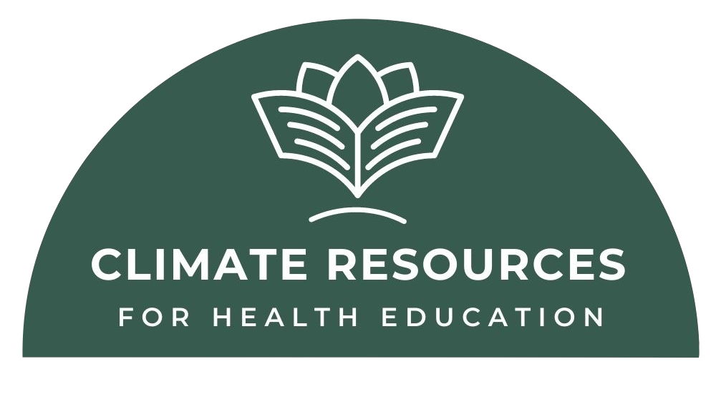
Particulate Matter and
Lung Cancer
Authors:
Katie E. Lichter MD,MPH, University of California of San Francisco
Sri Radhakrishnan, MD, University of Texas Southwestern
Sarah Briggs, MD, University of Oxford
Faculty Advisor:
Marjaneh Moini, MD
Updated: July 30, 2022

Slide 2
Learning Objectives:
Explain what particulate matter (PM) pollution is, why it is a health concern, and how climate change is affecting levels of PM?
Understand how incidence rates of lung cancer are increased with increased exposure to PM & PM2.5
Understand the global health disparities associated with increased exposure to PM.
Discuss clinical practices to decrease patient’s exposure to particulate matter.

Slide 3
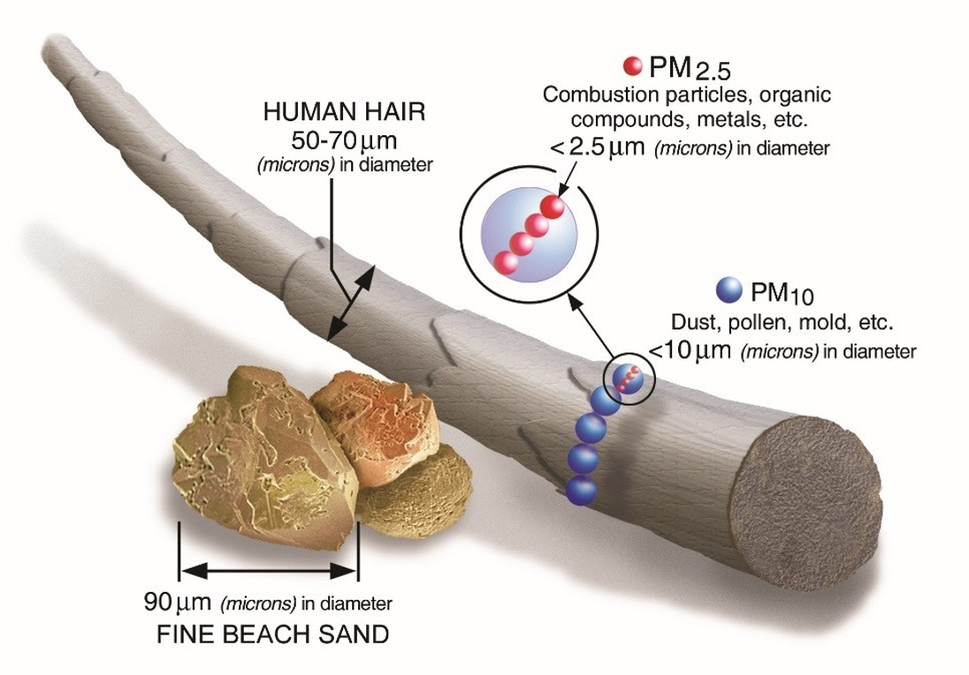
What is particulate matter (PM) pollution?
PM is a mixture of solid particles and liquid droplets found in the air and can be made up of hundreds of different chemicals including polycyclic aromatic hydrocarbons (PAHs).
Most particles form in the atmosphere as a result of complex reactions of pollutants emitted from power plants, industries and automobiles.
Climate change leads to increase in particulate matter pollution primarily due to wildfires and drought.
PM is defined by the size of the particle:
PM₁₀: coarse particles (D < 10 µm)
PM_{2.5}: fine particles (D < 2.5 µm)
PM_{0.1}: ultrafine particles (D < 0.1µm)
Source: https://www.epa.gov/pmcourse/what-particle-pollution
Notes:
What is particulate matter pollution?
Particulate matter (PM) pollution is a general term for a mixture of solid and liquid droplets suspended in the air and can be made up of hundreds of different chemicals including polycyclic aromatic hydrocarbons (PAHs).
PM is a major pollutant.
Particulate matter is defined by the size of the particles. Fine particles (PM_{2.5}) refers to particles that are 2.5 microns (µm) or less in diameter. Alternatively, a coarse particle (PM₁₀) has a diameter of 10 micrometers or less. A micron is a unit of measure for distance. For example, 20 PM_{2.5} particles could fit across the width of an average human hair (50-70 microns).
Particle pollution comes in many sizes and shapes and can be made up of a number of different components, including acids (sulfuric acid), inorganic compounds (such as ammonium sulfate, ammonium nitrate, and sodium chloride), organic chemicals, soot, metals, soil or dust particles, and biological materials (such as pollen and mold spores).
Where does particulate matter comes from?
Some particles, known as primary particles, are emitted directly from a source.
Primary particles from fossil fuel consumption can stem from power plants (coal and natural gas), gasoline/biofuel, and extractive industries (coal/mining/fracking). Particulates generated by human activities include construction of buildings and roads including particles from laying of asphalt and dust from dirt roads. Particles can also be generated from weather events including dust storms and wildfires (which are worsened by climate change).
Other particles, known as secondary particles, form in complicated atmospheric reactions involving chemicals such as sulfur dioxides and nitrogen oxides that are emitted from power plants, industries and automobiles. Secondary particles make up most of the fine particle pollution in the United States.
Particulate matter generated in the home can come from cooking, smoking, dusting, and vacuuming can also.
Particles produced by combustion are more likely to be fine particles, while particles of crustal (earth) and biological origin are more likely to be coarse particles.
Particle pollution is found everywhere - not just in haze, smoke, and dust, but also in air that looks clean. Particle pollution can occur year-round and presents air quality problems at concentrations found in many major cities throughout the United States. Some particles can remain in the atmosphere for days to weeks. Consequently, particle pollution generated in one area can travel hundreds or thousands of miles and influence the air quality of regions far from the original source.
Source: https://www.epa.gov/pmcourse/what-particle-pollution
Additional information of ultrafine particles
https://www.nature.com/articles/s12276-020-0403-3,
https://www.jacionline.org/article/S0091-6749(16)30011-2/fulltext
https://www.ncbi.nlm.nih.gov/pmc/articles/PMC8728691/

Slide 4
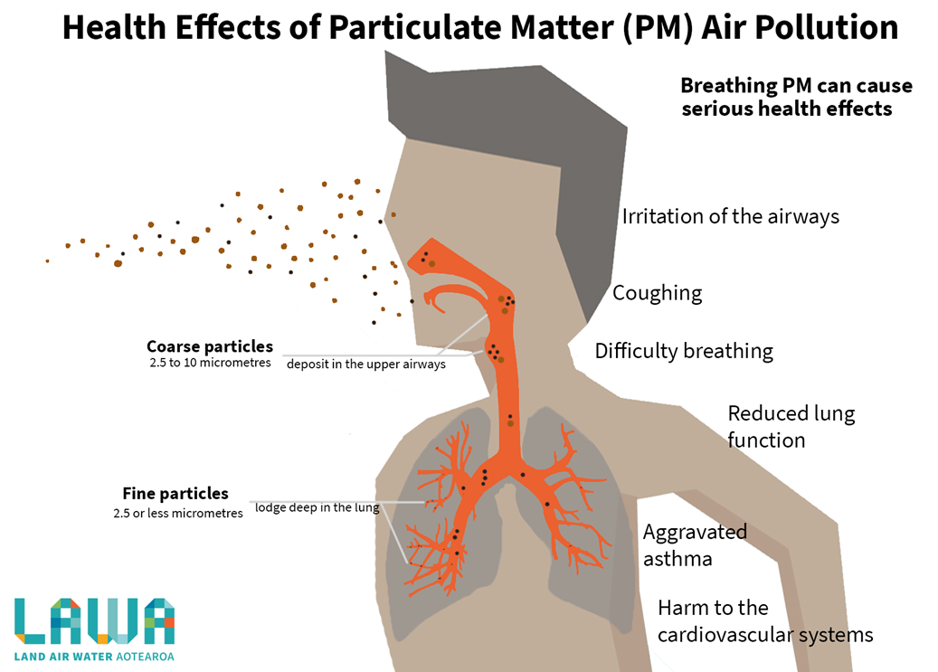
Additional Health effects of PM 2.5
The International Agency for Research on Cancer (IARC) published a review in 2015 that concluded that particulate matter in outdoor air pollution causes lung cancer.
Dementia/cognitive decline
Poor birth outcomes
Notes:
What are the health effects of exposure to particulate matter pollution?
Small PM2.5 participles are of particular concern given their ability to travel deep into the respiratory tract with the ability to reach the lungs. Coarse particles (> 10 µm) cannot travel as deep into the lungs but still have many negative health effects from acute and chronic exposure.
In 2015, the International Agency for Research on Cancer (IARC) published a review concluding that particulate matter in outdoor air pollution causes lung cancer.
An extensive body of scientific evidence shows that exposure to fine particles can cause cardiovascular effects, including heart attacks, heart failure, and strokes, which results in hospital admissions, emergency department visits, and, in some cases, premature death.
There is more limited scientific evidence for a broader range of health effects associated with fine particle exposure (e.g., developmental and reproductive effects, cancer) (U.S. EPA, 2009).
Source:
https://www.epa.gov/pmcourse/particle-pollution-exposure#intro
https://publications.iarc.fr/538

Slide 5
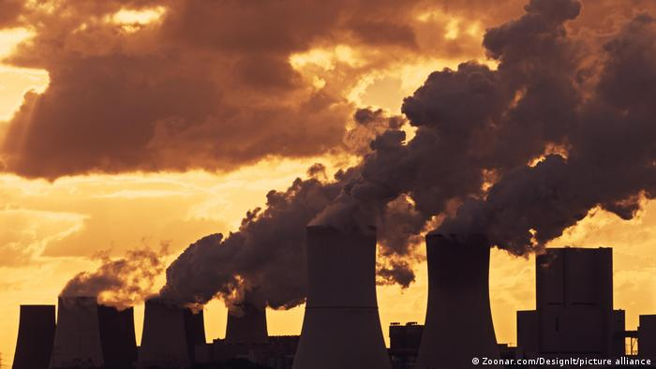
How does climate change affect exposures to PM?
Increasing emissions from fossil fuel-fired power plants due to demand for electricity for cooling
Increasing natural sources of air pollutant emissions
Wildfire smoke worsened by drought and heat
Slide credit: Christine Berg, MD
Notes:
How does climate change affect exposures to PM?
Increasing emissions from fossil fuel-fired power plants due to demand for electricity for cooling
Increasing natural sources of air pollutant emissions
Wildfire smoke induced by drought and heat
Image Source:
-https://www.dw.com/en/un-pandemic-did-not-slow-advance-of-climate-change/a-59197095

Slide 6
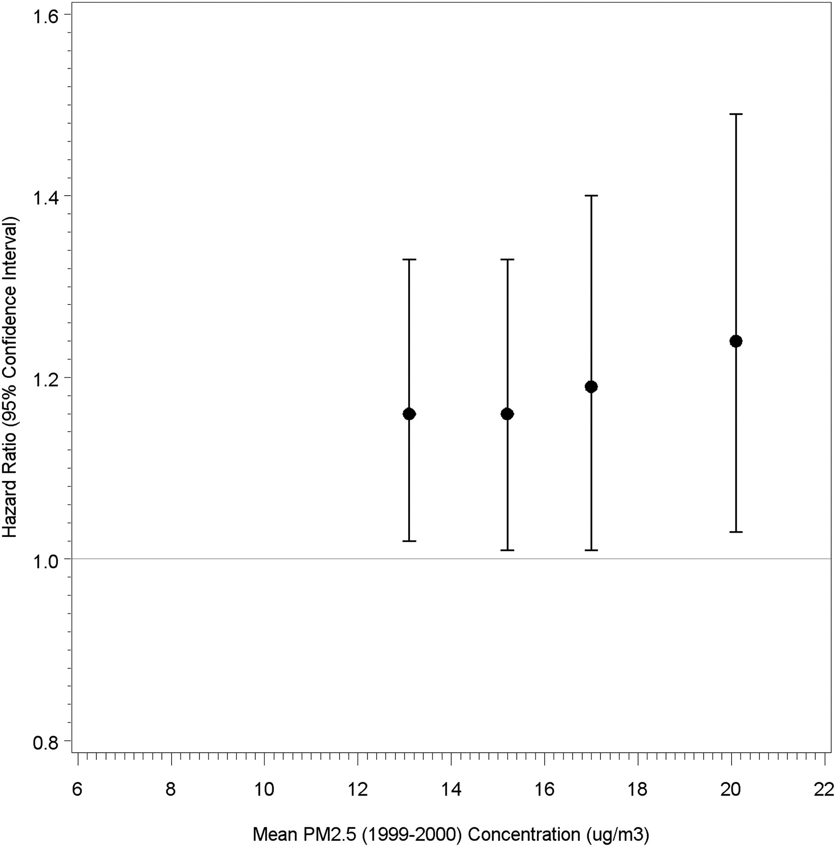
Prospective study: Long-term PM_{2.5} exposure and Lung CA mortality in Never-Smokers
Each 10 μg/m³ increase in PM_{2.5} concentrations was associated with a 15–27% increase in lung CA mortality
PM_{2.5} and lung CA mortality
No significant difference between sex, age, and education level
Stronger in those with a normal BMI or chronic lung disease at enrollment
Hazard ratio for lung CA mortality in relation to mean PM_{2.5} concentrations (in 1999-2000), for 26 yr follow-up (1982–2008) in never-smokers
Turner MC, et al. Am J Respir Crit Care Med. 2011
Notes:
The World Health Organization has estimated that long-term PM2.5 exposure is responsible for approximately 5% of all cancers of the trachea, bronchus, and lung
Objectives: This study by Turner et al examined the association between mean long-term ambient PM(2.5) concentrations and lung cancer mortality among 188,699 lifelong never-smokers drawn from the nearly 1.2 million Cancer Prevention Study-II participants enrolled by the American Cancer Society in 1982 and followed prospectively through 2008.
Study population: Studied nearly 1.2 million participants enrolled by over 77,000 volunteers in 1982 spanning all 50 states and the District of Columbia and Puerto Rico. The following groups were excluded: current or former cigarette smokers (702,427); individuals with missing data on vital status (46); prevalent cancer (except nonmelanoma skin cancer) at enrollment (33,852); missing ZIP code (39,093) or county (9,552) data
Measurements and main results: A total of 1,100 lung cancer deaths were observed during the 26-year follow-up period. Each 10 μg/m(3) increase in PM(2.5) concentrations was associated with a 15-27% increase in lung cancer mortality. The association between PM(2.5) and lung cancer mortality was similar in men and women and across categories of attained age and educational attainment, but was stronger in those with a normal body mass index and a history of chronic lung disease at enrollment (P < 0.05).
Conclusion: Positive associations noted between mean long-term ambient PM2.5 concentrations and lung cancer mortality in lifelong never-smokers, emphasizing that ambient concentrations of PM2.5 measured in recent decades are associated with small but measurable increases in lung cancer mortality. However, the magnitude of lung cancer risk associated with exposure to PM2.5 is notably smaller than that caused by active smoking
Source:
Turner MC, Krewski D, Pope CA 3rd, Chen Y, Gapstur SM, Thun MJ. Long-term ambient fine particulate matter air pollution and lung cancer in a large cohort of never-smokers. Am J Respir Crit Care Med. 2011 Dec 15;184(12):1374-81. doi: 10.1164/rccm.201106-1011OC. Epub 2011 Oct 6. PMID: 21980033.

Slide 7
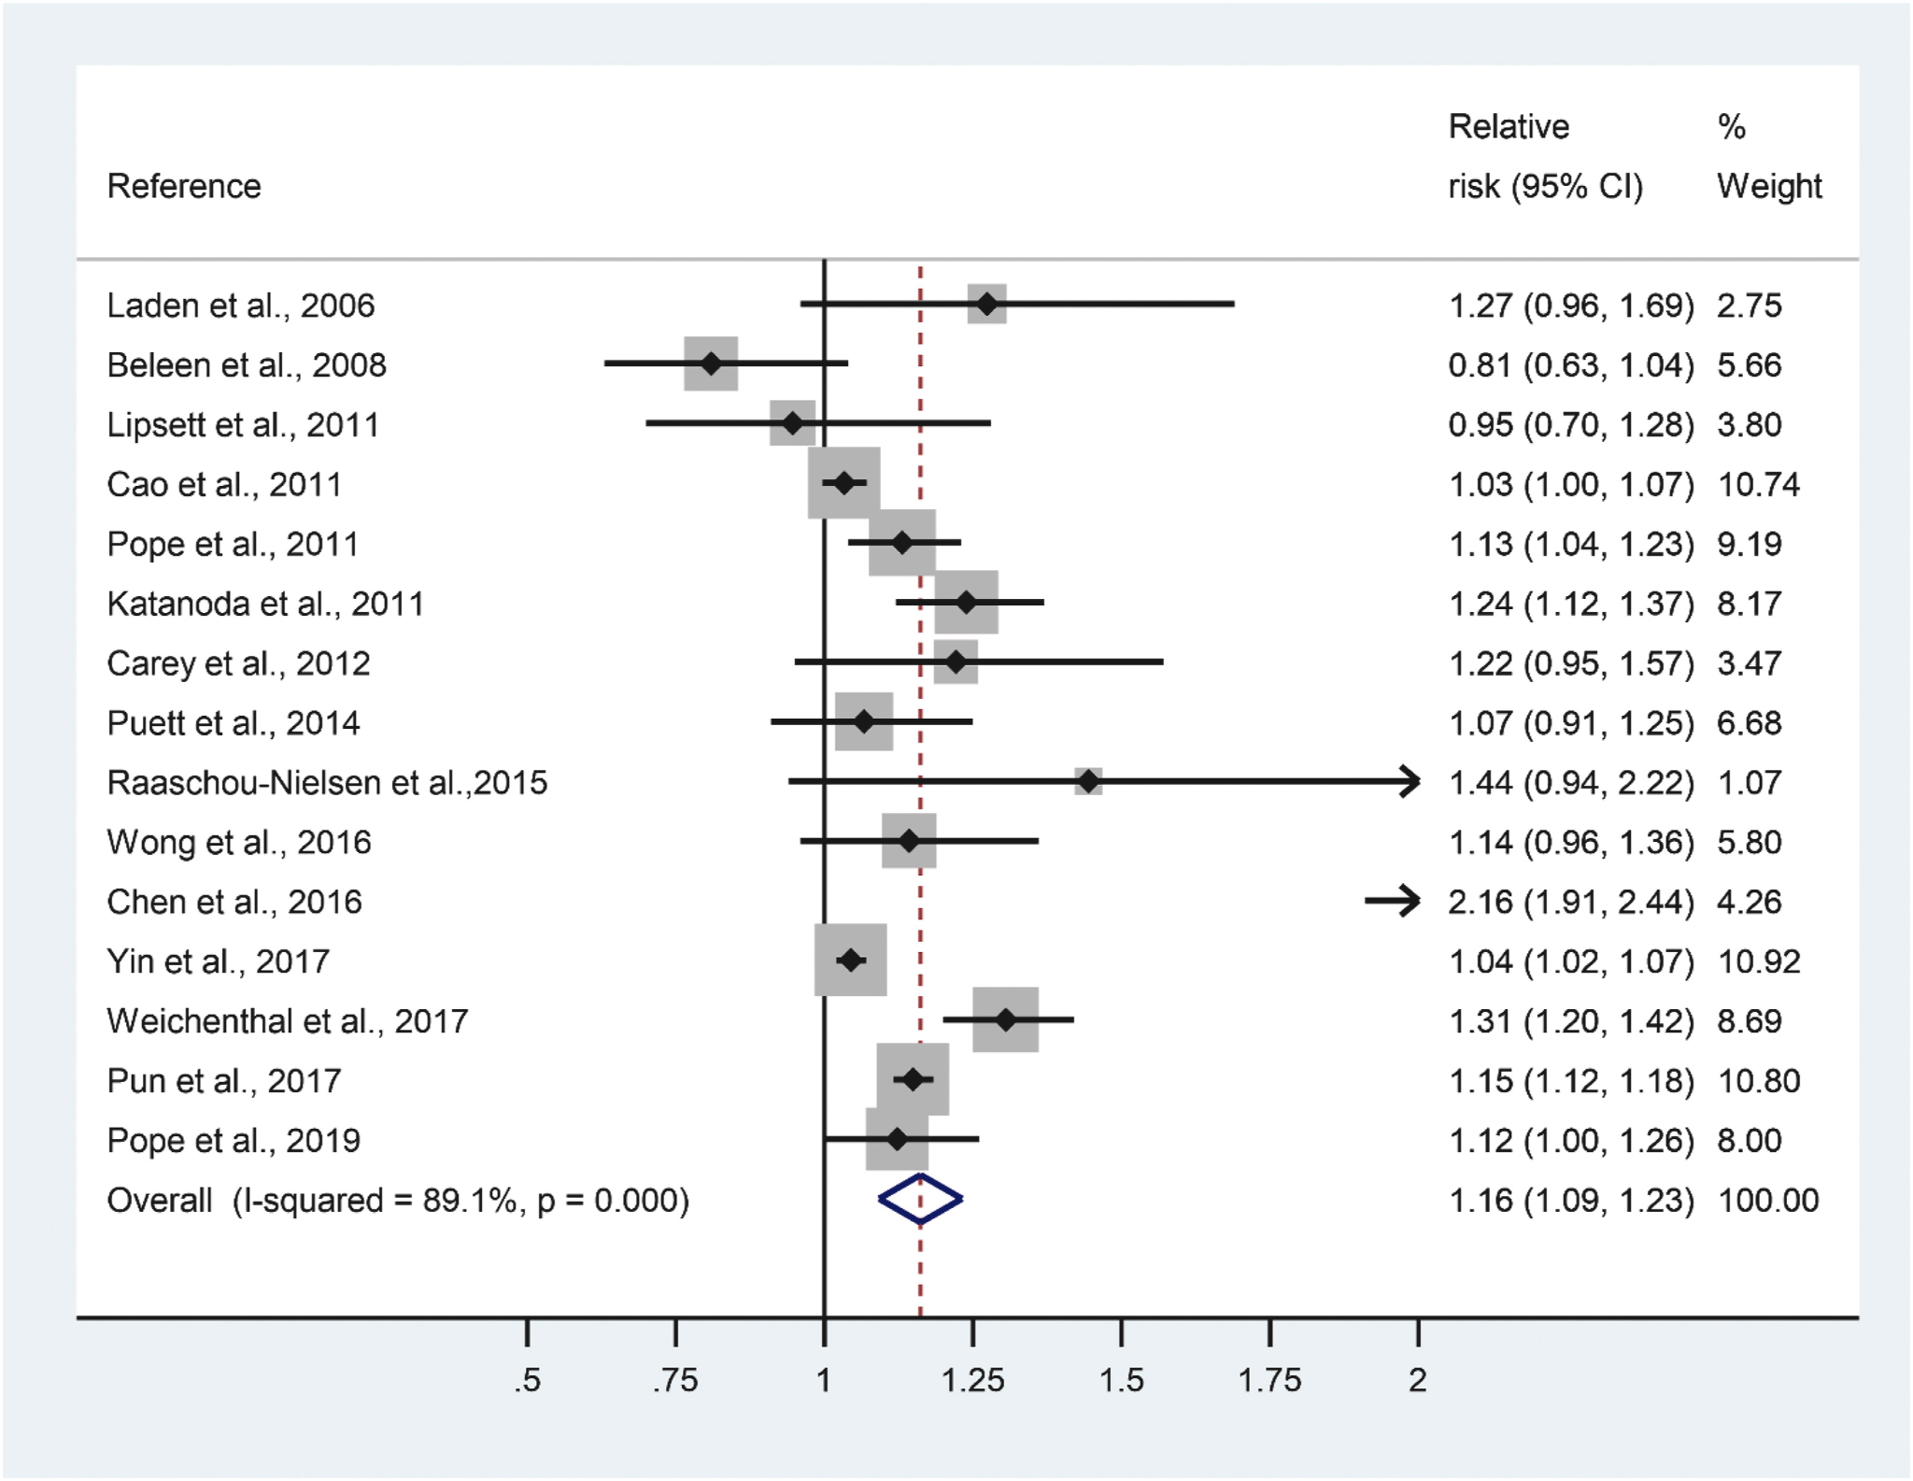
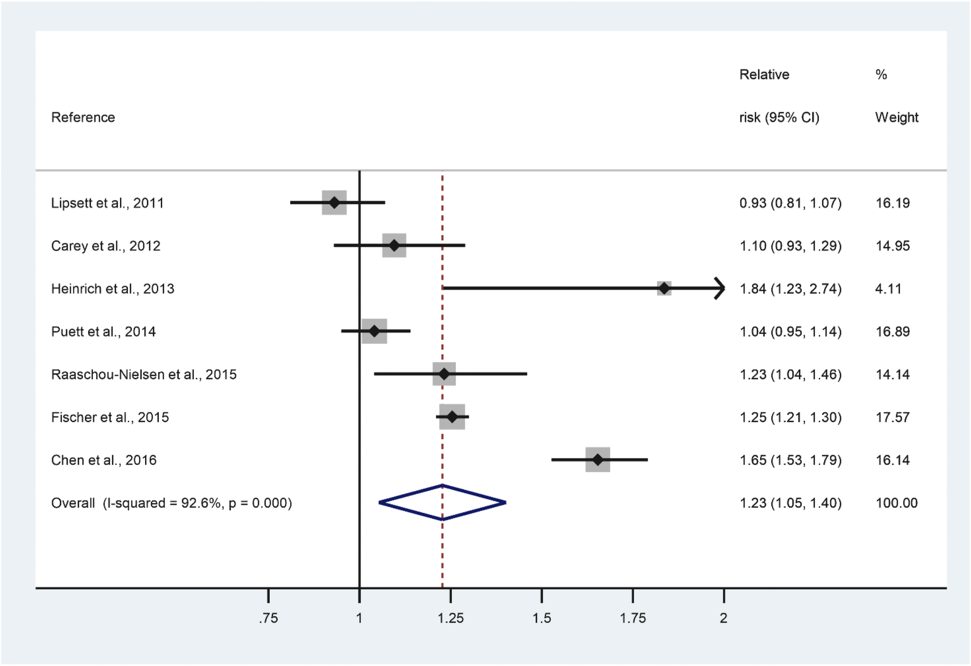
What is the risk of lung cancer with exposure to PM?
Meta-analysis of 17 studies estimating change in lung CA risk (incidence or mortality) per 10-μg/m³ increase in exposure to PM
Studies adjusted for smoking/socioeconomic status
RR for lung CA with PM_{2.5}: 1.16 (95% CI 1.09-1.23)
RR of lung CA with PM₁₀: 1.23 (95% CI 1.05-1.40)
Stratified analysis indicated higher associated risk in studies from East Asia
Europe (n=3) RR 1.09 (0.72-1.46)
N. America (n=7) RR 1.16 (1.09-1.22)
East Asia (n=5) RR 1.23 (1.11-1.36)
Ciabattini et al. Environ Res. 2021
Notes:
What is the risk of lung cancer with exposure to particulate matter?
There have been several meta-analyses published over the last decade summarising the evidence for the positive association of particulate matter with lung cancer risk
This 2021 meta-analysis from Ciabittini and colleagues included cohort studies published since 2004, which evaluated risk of lung cancer incidence or mortality with PM2.5 or PM10
All included studies adjusted for potential confounders of smoking status and socioeconomic status
They found the relative risk for every 10-μg/m3 increase in PM2.5 = 1.16. For PM10 = 1.23
Looking at studies by region, the associated risk appeared to be greatest in East Asian cohorts, compared to North America, and lowest in European studies
The authors also analysed risk of mortality and incidence separately, which suggested a higher risk for lung cancer mortality. If true, this could be a result of impact of PM on severity of disease, or could due to the effect of confounders - for example the impact of socioeconomic status on cancer outcomes
Source:
Ciabattini M, Rizzello E, Lucaroni F, Palombi L, Boffetta. Systematic review and meta-analysis of recent high-quality studies on exposure to particulate matter and risk of lung cancer. Environmental Research 2021;196:110440 https://doi.org/10.1016/j.envres.2020.110440

Slide 8
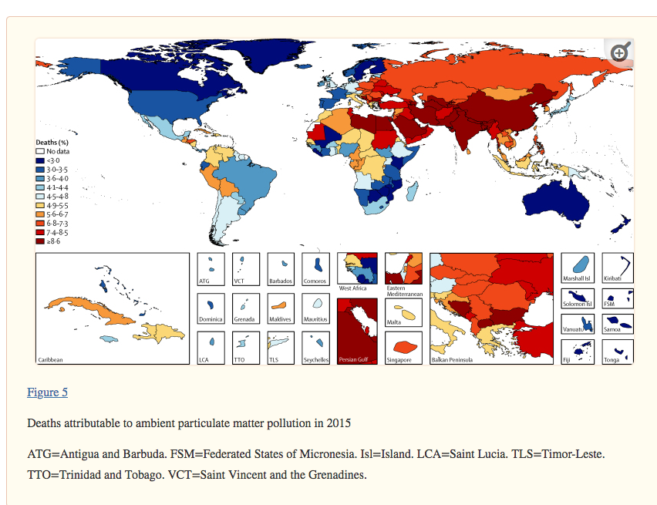
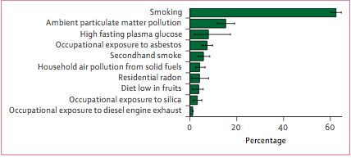
Global Burden of Disease Study
Deaths attributable to ambient PM_{2.5} increased from 3.5 million in 1990 to 4.2 million in 2015
Ambient PM_{2.5} air pollution contributed to 16.5% of lung cancer mortality in 2015 and 18.6% in 2017
Cohen et al. Lancet 2017
Notes:
What is the global burden of disease attributable to air pollution?
In 2017, the Lancet published a report evaluating “spatial and temporal trends in mortality and burden of disease attributable to ambient air pollution from 1990 to 2015 at global, regional, and country levels.”
They noted that deaths attributable to ambient PM2.5 have increased from 3.5 million in 1990 to an estimated 4.2 million in 2015, or 7.6% of total global deaths.
As a result, this is the 5th ranked global risk factor of 2015 for mortality
Exposure to ozone also attributed to additional 254,000 deaths.
In World Bank high-income countries, ambient PM_{2·5} exposure contributed to 4·3% of all deaths, 9·0% in upper-middle-income, 8·7% in lower-middle-income, and 4·9% in low-income countries.
From a global perspective, exposure to ambient air pollution and its associated burden of disease can be decreased at a national and subnational level via policies that promote aggressive air quality management programs
Source:
Cohen et al. Estimates and 25-year trends of the global burden of disease attributable to ambient air pollution: an analysis of data from the Global Burden of Diseases Study 2015. Lancet 2017;389(10082):1907-1918
Further resources:
https://www.thelancet.com/action/showPdf?pii=S0140-6736%2820%2930752-2 - 2019 GBD paper
https://ourworldindata.org/data-review-air-pollution-deaths - data review up to 2021, summarising evidence on air pollution related mortality

Slide 9
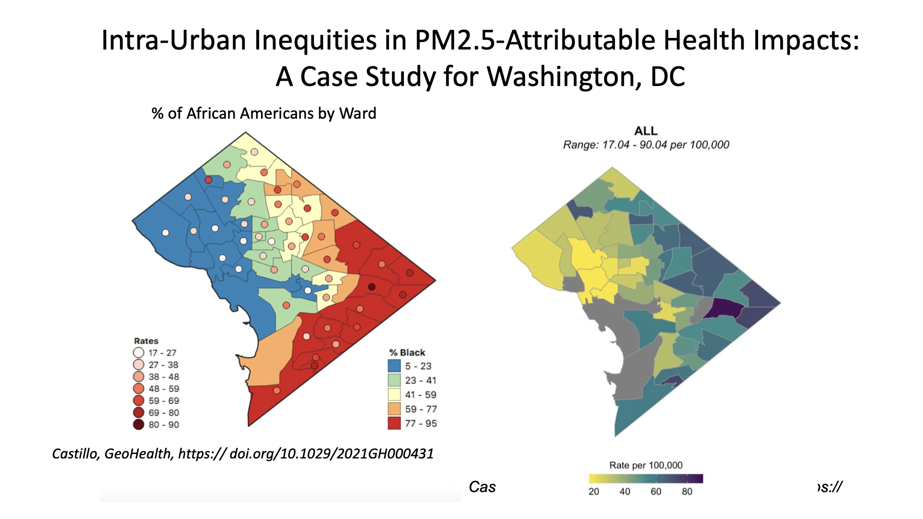
Increasing lung cancer risk for vulnerable populations
Castillo et al, GeoHealth 2021
Notes:
Climate change further magnifies health disparities, as the effects have a disproportionate impact on the most vulnerable populations (e.g., older populations, children, low-income populations, ethnic minorities, and patients with chronic conditions, including cancer) who are the least equipped to deal with these effects.
Evidence supports that low-income communities and communities of color are disproportionately exposed to PM_{2.5}, and thus more likely to be impacted by the ill effects of chronic air pollution and wildfire exposure.
Sources:
1.
Castillo MD, Kinney PL, Southerland V, et al. Estimating Intra-Urban Inequities in PM2.5-Attributable Health Impacts: A Case Study for Washington, DC. GeoHealth. 2021;5(11):e2021GH000431. doi:10.1029/2021GH000431
Keane RE, Karau E. Evaluating the ecological benefits of wildfire by integrating fire and ecosystem simulation models. Ecological Modelling. 2010;221(8):1162-1172. doi:10.1016/j.ecolmodel.2010.01.008
Liu JC, Wilson A, Mickley LJ, et al. Who Among the Elderly Is Most Vulnerable to Exposure to and Health Risks of Fine Particulate Matter From Wildfire Smoke? American Journal of Epidemiology. 2017;186(6):730-735. doi:10.1093/aje/kwx141
Ragavan MI, Marcil LE, Garg A. Climate Change as a Social Determinant of Health. Pediatrics. 2020;145(5):e20193169. doi:10.1542/peds.2019-3169
Vereinte Nationen, ed. Climate Change Resilience: An Opportunity for Reducing Inequalities. United Nations; 2016.
Levy BS, Patz JA. Climate Change, Human Rights, and Social Justice. Annals of Global Health. 2015;81(3):310-322. doi:10.1016/j.aogh.2015.08.008

Slide 10
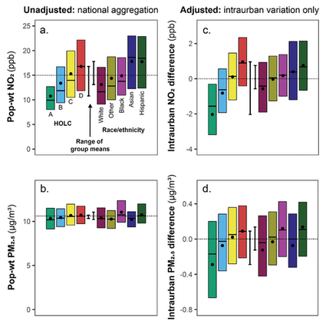
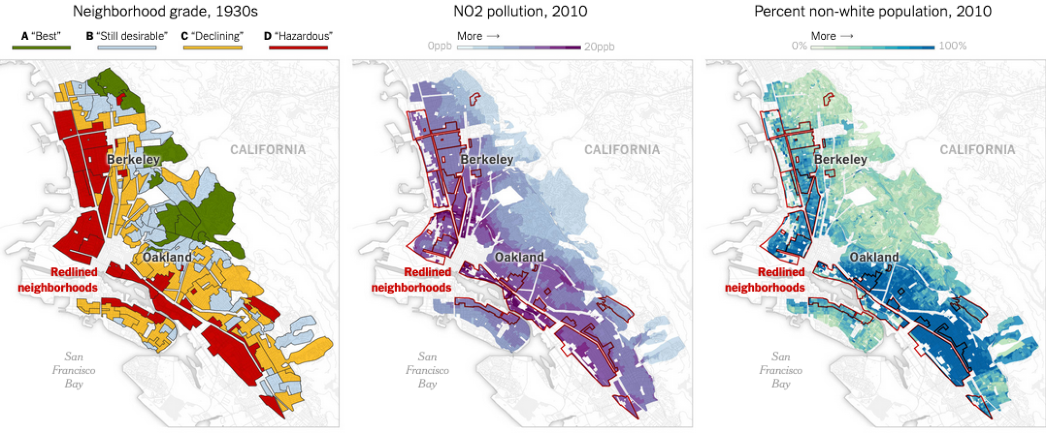
Home Owners' Loan Act “residential safety maps" otherwise known as Redlining prevented Black, Indigenous, Brown and Asian communities in United States from building intergenerational wealth.
NO2 and PM_{2.5} pollution levels are higher in historically “redlined” neighborhoods In US cities.
Haley M Lane, Environmental Science and Technology Letters
March 2022
Notes:
Disparities have been further exacerbated by historical redlining practices across numerous U.S. cities. These practices commonly known as “redlining practices” stem back to the Home Owners Loan Act which continue to negatively affect Black, Indigenous, Brown and Asian communities in the U.S.
Today research has shown that levels of air pollution, including N02 and PM2.5, are higher in historically “redlined” neighborhoods where these minority communities have historically been segregated to.
Sources:
https://pubs.acs.org/doi/10.1021/acs.estlett.1c01012
https://www.epa.gov/system/files/documents/2021-09/climate-vulnerability_september-2021_508.pdf

Slide 11
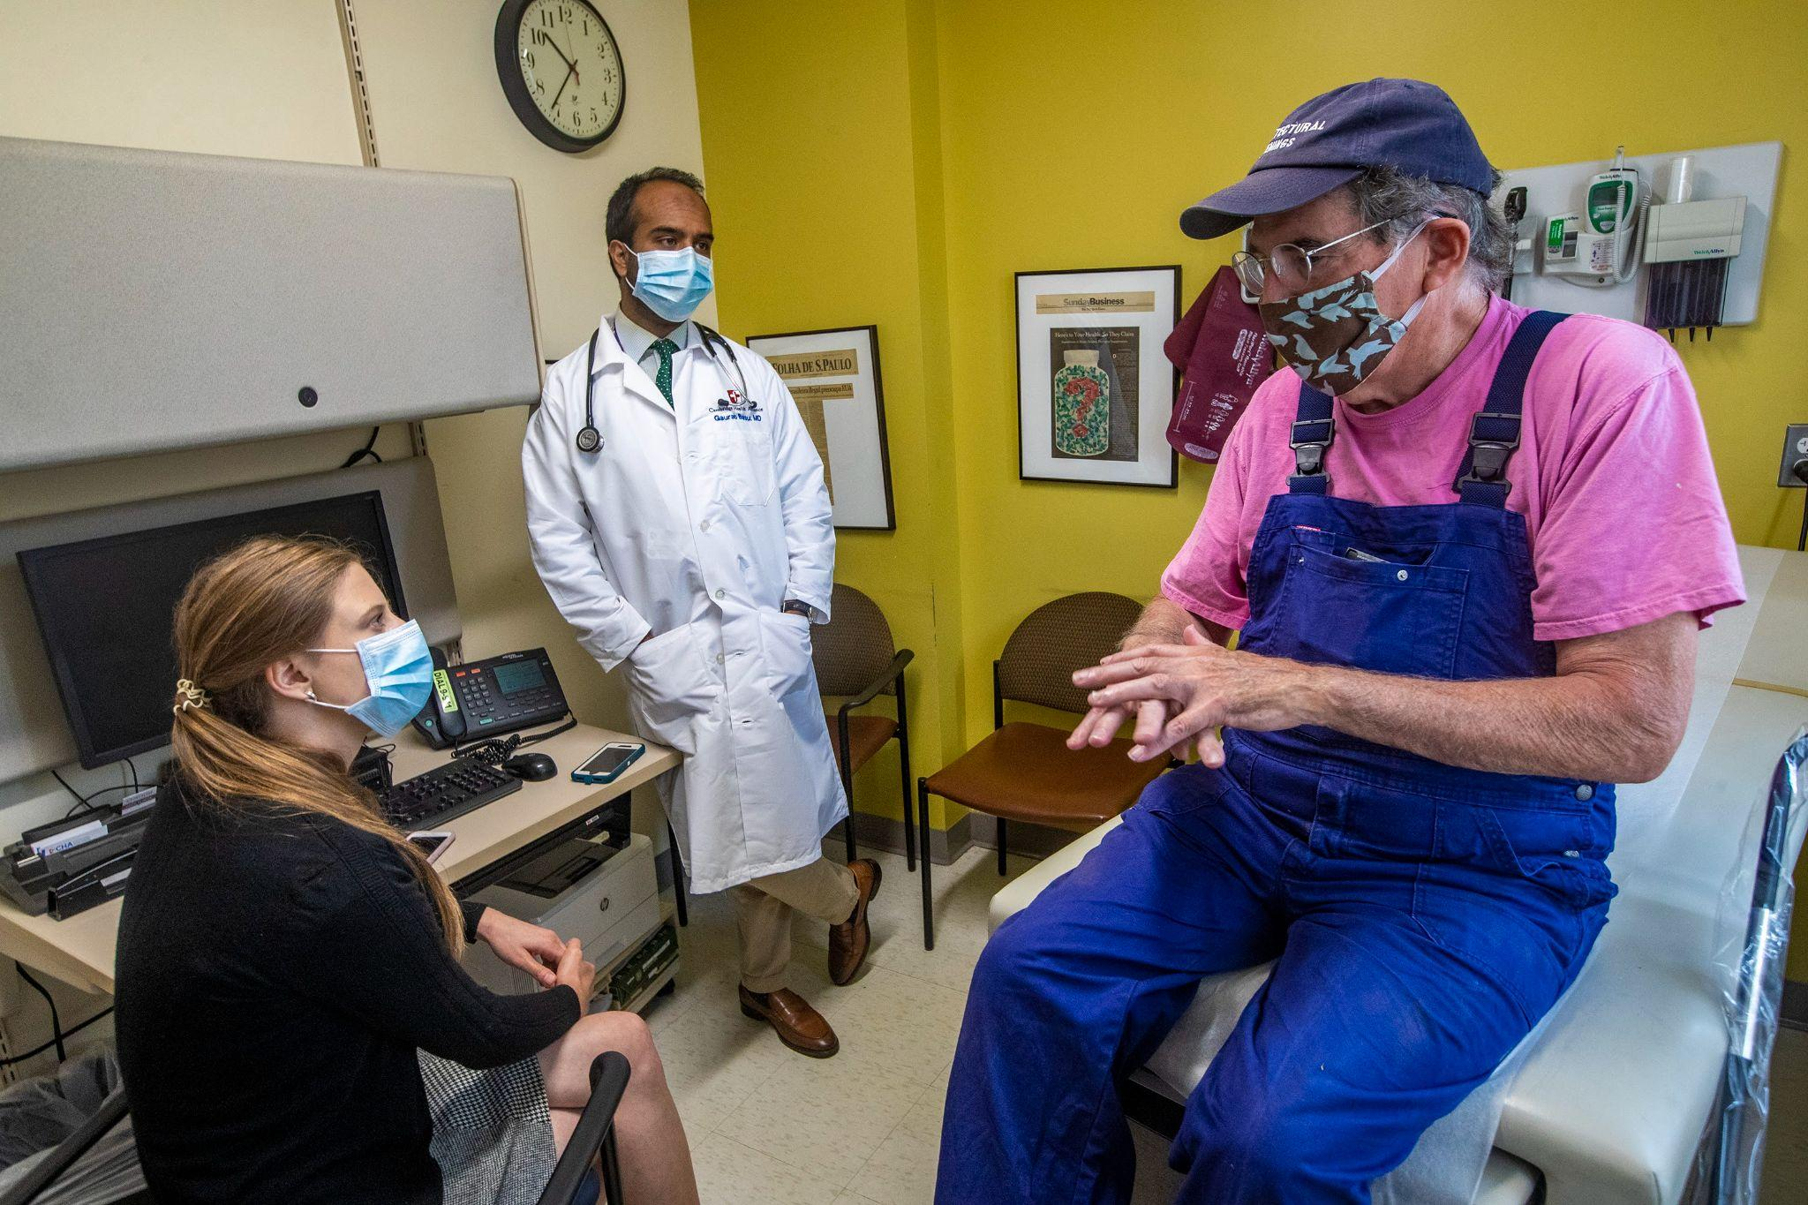
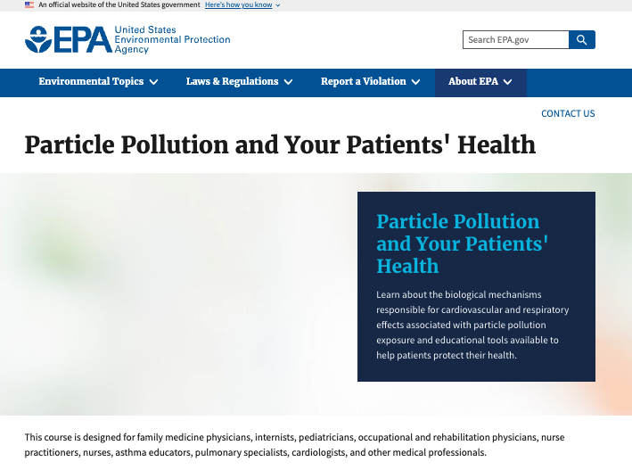
Implications for Clinical Practice
Physician EPA Course
Educate
Counsel patients to mitigate PM exposure (ex: N95 mask when appropriate, switch to electric appliances or ventilation when cooking)
Increase your own knowledge on particulate matter, tracking air quality, common exposures, and health effects
Advocate
Be a physician advocate on climate and health
Advocate for environmentally sustainable healthcare practice
Notes:
What are clinical practices to decrease patients exposure to particulate matter?
Educate - Counsel patients to mitigate PM exposure (ex: N95 mask when appropriate, switch to electric appliances or ventilation when cooking) - Increase your own knowledge on particulate matter, tracking air quality, common exposures, and health effects
Advocate - Be a physician advocate on climate and health - Advocate for environmentally sustainable healthcare practice
Source:
https://www.epa.gov/pmcourse

Slide 12
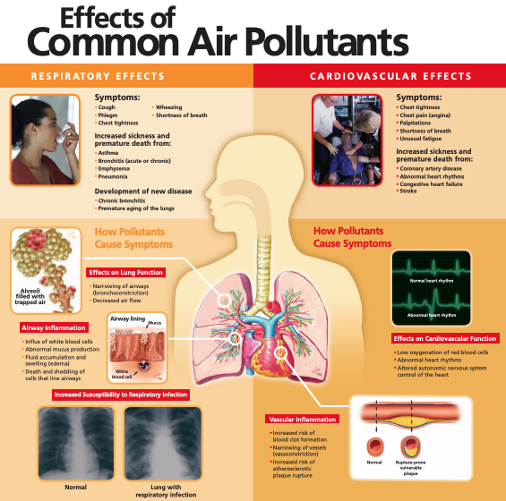
Patient Education Tools
Online Air Quality Guides
Mobile phone air tracking tools
Educational brochures
Notes:
Many tools exist today exist to help patients learn about PM and how to mitigate their exposure.
Air Quality Guide to Particle Pollution(PDF): This guide provides information about ways your patients can protect their health when particle pollution levels reach the unhealthy range and ways to help reduce particle air pollution.
Air Quality Index - A Guide to Air Quality and Your Health (PDF): This booklet explains EPA's Air Quality Index (AQI) and the health effects of major air pollutants.
AQI Forecasts: Your Advance Notification About Unhealthy Air (PDF): This brochure explains how to use the Air Quality Index and how high levels of ozone and particle matter can affect your health. Learn where this pollution comes from and what you can do to protect yourself when air quality is poor.
Effects of Common Air Pollutants Medical Poster: This colorful poster is designed for use in patient waiting areas or exam rooms to educate your patients about the health effects of air pollution on the respiratory and cardiovascular systems 8.5x11" standard version (PDF)
The AirNow Mobile App provides your patients with real-time air quality information that they can use to protect their health when planning their day. They can get location-specific reports on current air quality and air quality forecasts for both fine particle pollution and ozone.

Slide 13
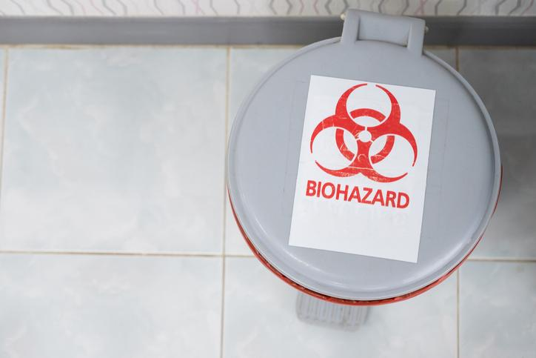
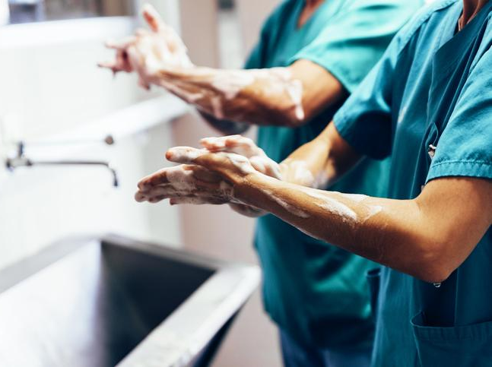
Go Green! Resident Best Practices
Minimize waste
Choose only the supplies you need for each procedure: Do you need a whole pre-packaged kit, or are 2-3 supplies enough?
Go reusable: Bring your own water bottle, coffee/tea mug, and utensils.
Compost
Paper towels and soiled napkins can be composted: Sort trash after each meal and each hand wash to decrease landfill waste.
Know your biohazard waste
Know what to throw in red bags: Processing biohazard waste has a huge environmental impact.
Choose video visits (when appropriate)
Video visits decrease waste and eliminate CO2: For clinic or hospital follow-up visits, choose video visits when appropriate.
Limit water use
Turn off the water while you scrub into surgery or wash your hands. Use alcohol-based hand sanitizers when appropriate.
Notes:
What can each of us do today?
All residents, students, and faculty can take an active role today in evaluating current practices and initiating changes to create sustainable, climate-smart healthcare practices which improve the clinical care of current and future patients. This is an opportunity for providers in every field to set a standard of sustainable practices and commitment towards social stewardship that can be modeled by other healthcare professionals and individuals in our communities.

